Slide 1

Management
Fourteenth Edition
Chapter 12
Managing Human Resources
Copyright © 2018, 2016, 2014 Pearson Education, Inc. All Rights Reserved

Slide 2
Learning Objectives
12.1 Explain the importance of human resource management and the human resource management process.
12.2 Describe the external influences that affect the human resource management process.
12.3 Discuss the tasks associated with identifying and selecting competent employees.
Know how to write effective job descriptions.
Develop your skill at being a good interviewer.
12.4 Explain how companies provide employees with skills and knowledge.
12.5 Describe strategies for retaining competent, high-performing employees.
12.6 Discuss contemporary issues in managing human resources.

Slide 3
Why Human Resource Management is Important and the Human Resource Management Process
Human resource management (HRM) can be a significant source of competitive advantage
HRM is an important part of organizational strategies
The way organizations treat their people can significantly impact performance
Notes:
HRM is important for three reasons. First, as various studies have concluded, it can be a significant source of competitive advantage. And that’s true for organizations around the world, not just U.S. firms.
Second, HRM is an important part of organizational strategies. Achieving competitive success through people means managers must change how they think about their employees and how they view the work relationship.
Finally, the way organizations treat their people has been found to significantly impact organizational performance. For instance, one study reported that improving work practices could increase market value by as much as 30 percent.

Slide 4
High-Performance Work Practices
High-performance work practices: work practices that lead to both high individual and high organizational performance
Notes:
The common thread among these practices seems to be a commitment to involving employees; improving the knowledge, skills, and abilities of an organization’s employees; increasing their motivation; reducing loafing on the job; and enhancing the retention of quality employees while encouraging low performers to leave.
Even if an organization doesn’t use high-performance work practices, other specific HRM activities must be completed in order to ensure that the organization has qualified people to perform the work that needs to be done—activities that compose the HRM process.

Slide 5
Exhibit 12-1 High-Performance Work Practices
Practices
Self-managed teams
Decentralized decision making
Training programs to develop knowledge, skills, and abilities
Flexible job assignments
Open communication
Performance-based compensation
Staffing based on person-job and person-organization fit
Extensive employee involvement
Giving employees more control over decision making
Increasing employee access to information
Notes:
Sources: C. H. Chuang and H. Liao, “Strategic Human Resource Management in Service Context: Taking Care of Business by Taking Care of Employees and Customers,” Personnel Psychology, Spring 2010, pp. 153–196; M. Subramony, “A Meta-Analytic Investigation of the Relationship Between HRM Bundles and Firm Performance,” Human Resource Management, September–October 2009, pp. 745–768; M. M. Butts et al., “Individual Reactions to High Involvement Work Practices: Investigating the Role of Empowerment and Perceived Organizational Support,” Journal of Occupational Health Psychology, April 2009, pp. 122–136; and
W. R. Evans and W. D. Davis, “High-Performance Work Systems and Organizational Performance: The Mediating Role of Internal Social Structure,” Journal of Management, October 2005, p. 760.

Slide 6
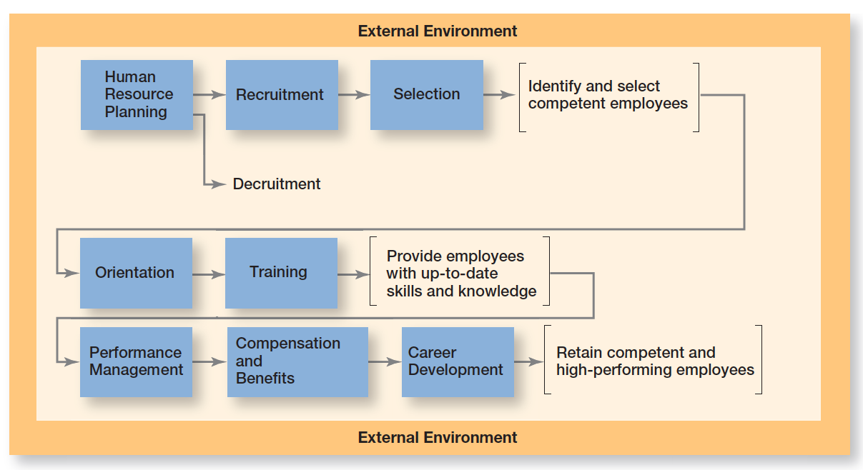
Exhibit 12-2 HRM Process
Exhibit 12-2 shows the eight steps in the HRM process.
Notes:
Exhibit 12-2 shows the eight activities in this process. The first three activities ensure that competent employees are identified and selected; the next two involve providing employees with up-to-date knowledge and skills; and the final three ensure that the organization retains competent and high-performing employees. Before we discuss those specific activities, we need to look at external factors that affect the HRM process.

Slide 7
L01: External Factors that Affect the Human Resource Management Process
the entire HRM process is inªuenced by the external environment. Those factors most directly inªuencing it include the economy, employee labor unions,governmental laws and regulations, and demographic trends
1. The economy: lasting impact of the Great Recession 2016
Notes:
The entire HRM process is influenced by the external environment. Those factors most directly influencing it include the economy, employee labor unions, governmental laws and regulations, and demographic trends.
The global economic downturn has left what many experts believe to be an enduring mark on HRM practices worldwide. In the United States, labor economists say that although jobs may be coming back slowly, they aren’t the same ones that employees were used to. Many of these jobs are temporary or contract positions, rather than full-time jobs with benefits.

Slide 8
2. Labor Unions
Labor union: an organization that represents workers and seeks to protect their interests through collective bargaining
Air traffic controller, oil tankers association of Pakistan
Notes:
A labor union is an organization that represents workers and seeks to protect their interests through collective bargaining. In unionized organizations, many HRM decisions are dictated by collective bargaining agreements, which usually define things such as recruitment sources; criteria for hiring, promotions, and layoffs; training eligibility; and disciplinary practices. Work stops, labor disputes, and negotiations between management and labor are just a few of the challenges organizations and managers face when their workforce is unionized.

Slide 9
3. Laws and Rulings
Decisions regarding who will be hired or which employees will be chosen for a training program or what an employee’s compensation will be must be made without regard to race, sex, religion, age, color, national origin, pregnancy, or disability.
Number of important laws and regulations what you can and cannot do legally as a manager. Because workplace lawsuits are increasingly targeting supervisors, as well as their organizations, managers must know what they can and cannot do by law.
Affirmative action: Organizational programs that enhance the status of members of protected groups
Notes:
An organization’s HRM practices are governed by a country’s laws. A number of important laws and regulations affect what you can and cannot do legally as a manager. Because workplace lawsuits are increasingly targeting supervisors, as well as their organizations, managers must know what they can and cannot do by law. (See Exhibit 12-3 for some of the important U.S. laws that affect the HRM process.)
Many U.S. organizations have affirmative action programs to ensure that decisions and practices enhance the employment, upgrading, and retention of members from protected groups such as minorities and females. That is, an organization refrains from discrimination and actively seeks to enhance the status of members from protected groups.
We do want to mention two current U.S. laws that each have the potential to affect future HRM practices. The first of these, the Patient Protection and Affordable Care Act (PPACA; commonly called the Health Care Reform Act), was signed into law in March 2010 and upheld by the Supreme Court of the United States in 2012.
The Social Networking Online Protection Act (SNOPA) has been introduced and would prohibit employers from requiring
a username, password, or other access to online content.

Slide 10
Exhibit 12-3: Major HRM Laws—Equal Employment Opportunity and Discrimination
Law or Ruling | Year | Description
Equal Pay Act | 1963 | Prohibits pay differences for equal work based on gender
Civil Rights Act, Title VII | 1964 (amended 1972) | Prohibits discrimination based on race, color, religion, national origin, or gender
Age Discrimination in Employment Act | 1967 (amended 1978) | Prohibits discrimination against employees 40 years and older
Vocational Rehabilitation Act | 1973 | Prohibits discrimination on the basis of physical or mental disabilities
Americans with Disabilities Act | 1990 | Prohibits discrimination against individuals who have disabilities or chronic illnesses; also requires reasonable accommodations for these individuals
Notes:
Sources: U.S. Equal Employment Opportunity Commission, www.eeoc.gov; U.S. Department of Labor, www.dol.gov; U.S. Occupational Safety and Health Administration, www.osha.gov.

Slide 11
Exhibit 12-3: Major HRM Laws—Compensation/Benefits
Law or Ruling | Year | Description
Worker Adjustment and Retraining Notification Act | 1990 | Requires employers with more than 100 employees to provide 60 days’ notice before a mass layoff or facility closing
Family and Medical Leave Act | 1993 | Gives employees in organizations with 50 or more employees up to 12 weeks of unpaid leave each year for family or medical reasons
Health Insurance Portability and Accountability Act | 1996 | Permits portability of employees’ insurance from one employer to another
Lilly Ledbetter Fair Pay Act | 2009 | Changes the statute of limitations on pay discrimination to 180 days from each paycheck
Patient Protection and Affordable Care Act | 2010 | Health care legislation that puts in place comprehensive health insurance reforms
Notes:
Sources: U.S. Equal Employment Opportunity Commission, www.eeoc.gov; U.S. Department of Labor, www.dol.gov; U.S. Occupational Safety and Health Administration, www.osha.gov.

Slide 12
Exhibit 12-3: Major HRM Laws—Health/Safety
Law or Ruling | Year | Description
Occupational Safety and Health Act (OSHA) | 1970 | Establishes mandatory safety and health standards in organizations
Privacy Act | 1974 | Gives employees the legal right to examine personnel files and letters of reference
Consolidated Omnibus Reconciliation Act (COBRA) | 1985 | Requires continued health coverage following termination (paid by employee)
Notes:
Sources: U.S. Equal Employment Opportunity Commission, www.eeoc.gov; U.S. Department of Labor, www.dol.gov; U.S. Occupational Safety and Health Administration, www.osha.gov.

Slide 13
Global HRM
Work councils: groups of nominated or elected employees who must be consulted when management makes decisions involving personnel
Board representatives: employees who sit on a company’s board of directors and represent the interests of the firm’s employees
Notes:
What about HRM laws globally? It’s important that managers in other countries be familiar with the specific laws that apply there.
In western Europe, the two most common forms of representative participation are work councils and board representatives. Work councils link employees with management. They are groups of nominated or elected employees who must be consulted when management makes decisions involving personnel. Board representatives are employees who sit on a company’s board of directors and represent the interests of the firm’s employees.

Slide 14
4.Demography
The oldest, most experienced workers (those born before 1946) make up 6% of the workforce
Baby boomers (1945-64) make up 41.5% of the workforce
Gen Xers(1965-77) make up almost 29% of the workforce
Gen Yers (1978 to 1994) make up almost 24% of the workforce
Notes:
Workforce trends in the early twenty-first century will be notable for three reasons: (1) changes in racial and ethnic composition, (2) an aging baby boom generation, and (3) an expanding cohort of Gen Y workers.
Meanwhile, the labor force is aging. The 55-and-older age group, which currently makes up 13 percent of the workforce, will increase to 20 percent by 2014. Another group that’s having a significant impact on today’s workforce is Gen Y, a population group that includes individuals born from about 1978 to 1994. Gen Y has been the fastest-growing segment of the workforce—increasing from 14 percent to more than 24 percent. With Gen Y now in the workforce, analysts point to the four generations that are working side-by-side in the workplace.

Slide 15
L: 03 Identifying and selecting competent employees
Every organization needs people to do whatever work is necessary for doing what the organization is in business to do. How do they get those people? And more importantly, what can they do to ensure they get competent, talented people? This first phase of the HRM process involves three tasks: human resource planning, recruitment and decruitment, and selection

Slide 16
Human Resource Planning
Human resource planning: ensuring that the organization has the right number and kinds of capable people in the right places and at the right times
Two steps:
Assessing current human resources
Meeting future HR needs
Notes:
Human resource planning is the process by which managers ensure that they have the right number and kinds of capable people in the right places and at the right times. Through planning, organizations avoid sudden people shortages and surpluses. HR planning entails two steps: (1) assessing current human resources and (2) meeting future HR needs.

Slide 17
Current Assessment
Job analysis: an assessment that defines jobs and the behaviors necessary to perform them
Job description (position description): a written statement that describes a job
Job specifications: a written statement of the minimum qualifications a person must possess to perform a given job successfully
Notes:
Managers begin HR planning by inventorying current employees. This inventory usually includes information on employees such as name, education, training, prior employment, languages spoken, special capabilities, and specialized skills. Sophisticated databases make getting and keeping this information quite easy.

Slide 18
Meeting Future HR Needs/Increased Scrutiny in Selection Process
Future HR needs are determined by the organization’s mission, goals, and strategies.
Companies that do not carefully scrutinize the qualifications or backgrounds of employees surely pose risks of increased liability, poor reputation, and lower performance.
Notes:
Demand for employees results from demand for the organization’s products or services. After assessing both current capabilities and future needs, managers can estimate areas in which the organization will be understaffed or overstaffed. Then they’re ready to proceed to the next step in the HRM process.
A driver at Fresh Direct, an online grocer that delivers food to masses of apartment-dwelling New Yorkers, was charged with, and later pled guilty to, stalking and harassing female customers. San Francisco and Los Angeles prosecutors have accused ride-hailing service Uber of misleading the public about the rigor of driver background checks and claim of “safety you can trust.” The prosecutors maintain that Uber’s selection process led to the employment of individuals using false names and convicted of sex offenses, murder, and kidnapping. What do these outcomes suggest? Both companies have used selection processes that do not consistently screen out unsuitable applicants.

Slide 19
Recruitment and Decruitment
Recruitment: locating, identifying, and attracting capable applicants
Decruitment: reducing an organization’s workforce
Notes:
If employee vacancies exist, managers should use the information gathered through job analysis to guide them in recruitment—that is, locating, identifying, and attracting capable applicants. On the other hand, if HR planning shows a surplus of employees, managers may want to reduce the organization’s workforce through decruitment.

Slide 20
Exhibit 12-4: Recruiting Sources
Source | Advantages | Disadvantages
Internet | Reaches large numbers of people; can get immediate feedback | Generates many unqualified candidates
Employee referrals | Knowledge about the organization provided by current employee; can generate strong candidates because a good referral reflects on the recommender | May not increase the diversity and mix of employees
Company website | Wide distribution; can be targeted to specific groups | Generates many unqualified candidates
College recruiting | Large centralized body of candidates | Limited to entry-level positions
Professional recruiting organizations | Good knowledge of industry challenges and requirements | Little commitment to specific organization
Notes:
Exhibit 12-4 explains different recruitment sources managers can use to find potential job candidates.

Slide 21
Exhibit 12-5: Decruitment Options
Option | Description
Firing | Permanent involuntary termination
Layoffs | Temporary involuntary termination; may last only a few days or extend to years
Attrition | Not filling openings created by voluntary resignations or normal retirements
Transfers | Moving employees either laterally or downward; usually does not reduce costs but can reduce intraorganizational supply–demand imbalances
Reduced workweeks | Having employees work fewer hours per week, share jobs, or perform their jobs on a part-time basis
Early retirements | Providing incentives to older and more senior employees for retiring before their normal retirement date
Job sharing | Having employees share one full-time position
Notes:
The other approach to controlling labor supply is decruitment, which is not a pleasant task for any manager. Decruitment options are shown in Exhibit 12-5. Although employees can be fired, other choices may be better. However, no matter how you do it, it’s never easy to reduce an organization’s workforce.

Slide 22
Selection
Selection: screening job applicants to ensure that the most appropriate candidates are hired
Notes:
Once you have a pool of candidates, the next step in the HRM process is selection, screening job applicants to determine who is best qualified for the job. Managers need to “select” carefully since hiring errors can have significant implications.
Selection involves predicting which applicants will be successful if hired. As shown in Exhibit 12-6, any selection decision can result in four possible outcomes—two correct and two errors.

Slide 23
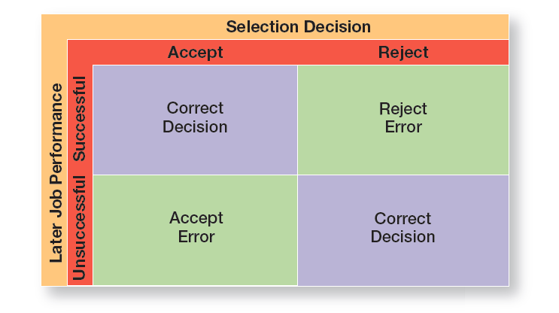
Exhibit 12-6 Selection Decision Outcomes
As shown in Exhibit 12-6, any selection decision can result in four possible outcomes—two correct and two errors.
Notes:
As shown in Exhibit 12-6, any selection decision can result in four possible outcomes—two correct and two errors.
A decision is correct when the applicant was predicted to be successful and proved to be successful on the job, or when the applicant was predicted to be unsuccessful and was not hired. In the first instance, we have successfully accepted; in the second, we have successfully rejected.

Slide 24
Validity and Reliability
A valid selection device is characterized by a proven relationship between the selection device and some relevant criterion.
A reliable selection device indicates that it measures the same thing consistently.
Notes:
Federal employment laws prohibit managers from using a test score to select employees unless clear evidence shows that, once on the job, individuals with high scores on this test outperform individuals with low test scores.
On a test that’s reliable, any single individual’s score should remain fairly consistent over time, assuming that the characteristics being measured are also stable. No selection device can be effective if it’s not reliable.
A growing number of companies are adopting a new measure of recruitment effectiveness called “quality of ll.” This measure looks at the contributions of good hires versus those of hires who have failed to live up to their potential. Five key factors are considered in defining this quality measure

Slide 25
Exhibit 12-7: Selection Tools
Tool | Characteristics
Application forms | Almost universally used Most useful for gathering information Can predict job performance but not easy to create one that does
Written tests | Must be job-related Include intelligence, aptitude, ability, personality, and interest tests Are popular (e.g., personality tests; aptitude tests) Relatively good predictor for supervisory positions
Performance simulation tests | Use actual job behaviors Work sampling—test applicants on tasks associated with that job; appropriate for routine or standardized work Assessment center—simulate jobs; appropriate for evaluating managerial potential
Interviews | Almost universally used Must know what can and cannot be asked Can be useful for managerial positions
Background investigations | Used for verifying application data—valuable source of information Used for verifying reference checks—not a valuable source of information
Physical examinations | Are for jobs that have certain physical requirements Mostly used for insurance purposes
Notes:
Exhibit 12-7 lists the strengths and weaknesses of each. Because many selection tools have limited value for making selection decisions, managers should use those that effectively predict performance for a given job.

Slide 26
Realistic Job Preview
Realistic job preview (RJP): a preview of a job that provides both positive and negative information about the job and the company
Notes:
One thing managers need to carefully watch is how they portray the organization and the work an applicant will be doing. If they tell applicants only the good aspects, they’re likely to have a workforce that’s dissatisfied and prone to high turnover.
To increase employee job satisfaction and reduce turnover, managers should consider a realistic job preview (RJP), one that includes both positive and negative information about the job and the company.

Slide 27
PROVIDING employees with needed skills and knowledge
If recruiting and selecting are done properly, we should have hired competent individuals who can perform successfully on the job. But successful performance requires more than possessing certain skills.
New hires must be acclimated to the organization’s culture and be trained and given the knowledge to do the job in a manner consistent with the organization’s goals.

Slide 28
Orientation
Orientation: introducing a new employee to his or her job and the organization
Work unit orientation
Organization orientation
Notes:
A person starting a new job needs the same type of introduction to his or her job and the organization. This introduction is called orientation. There are two types of orientation. Work unit orientation familiarizes the employee with the goals of the work unit, clarifies how his or her job contributes to the unit’s goals, and includes an introduction to his or her new coworkers. Organization orientation informs the new employee about the company’s goals, history, philosophy, procedures, and rules. It should also include relevant HR policies and maybe even a tour of the facilities.
Employee training is an important HRM activity. As job demands change, employee skills have to change. In 2011, U.S. business firms spent more than $59 billion on formal employee training. Managers, of course, are responsible for deciding what type of training employees need, when they need it, and what form that training should take.

Slide 29
Employee Training
On average, U.S. companies spent $702 per employee for training.
To learn specific tasks to be carried out at organization
Notes:
Employee training is an important HRM activity. As job demands change, employee skills have to change. In 2015, U.S. business firms spent more than $70.6 billion on formal employee training. Managers, of course, are responsible for deciding what type of training employees need, when they need it, and what form that training should take.

Slide 30
Exhibit 12-8 Types of Training
Exhibit 12-8 describes the major types of training that organizations provide.
Notes:
Source: Based on “2005 Industry Report—Types of Training,” Training, December 2005, p. 22.

Slide 31
Exhibit 12-9: Traditional Training Methods
Method | Characteristics
On-the-job | Employees learn how to do tasks simply by performing them, usually after an initial introduction to the task.
Job rotation | Employees work at different jobs in a particular area, getting exposure to a variety of tasks.
Mentoring and coaching | Employees work with an experienced worker who provides information, support, and encouragement; also called apprenticeships in certain industries.
Experiential exercises | Employees participate in role-playing, simulations, or other face-to-face types of training.
Workbooks/ manuals | Employees refer to training workbooks and manuals for information.
Classroom lectures | Employees attend lectures designed to convey specific information.
Notes:
Exhibit 12-9 provides a description of the various traditional and technology-based training methods that managers might use. Of all these training methods, experts believe that organizations will increasingly rely on e-learning and mobile applications to deliver important information and to develop employees’ skills.

Slide 32
Exhibit 12-9: Technology-Based Training Methods
Method | Characteristics
CD-ROM/DVD/ videotapes/audiotapes/ podcasts | Employees listen to or watch selected media that convey information or demonstrate certain techniques.
Videoconferencing/ teleconferencing/satellite TV | Employees listen to or participate as information is conveyed or techniques demonstrated.
E-learning | Internet-based learning where employees participate in multimedia simulations or other interactive modules.
Mobile learning | Learning delivered via mobile devices.
Notes:
Exhibit 12-9 provides a description of the various traditional and technology-based training methods that managers might use. Of all these training methods, experts believe that organizations will increasingly rely on e-learning and mobile applications to deliver important information and to develop employees’ skills.

Slide 33
RETAINING competent, high-performing employees
Once an organization has invested significant dollars in recruiting, selecting, orienting, and training employees, it wants to keep them, especially the competent, high performing ones!
Two HRM activities that play a role in this area are managing employee performance and
developing an appropriate compensation and benefits program

Slide 34
Employee Performance Management
Performance management system: establishes performance standards used to evaluate employee performance
More than 70 percent of managers admit they have trouble giving a critical performance review to an underachieving mployee. It’s particularly challenging when managers and employees alike sense they’re not benefcial.
Notes:
A performance management system establishes performance standards used to evaluate employee performance. How do managers evaluate employees’ performance? That’s where the different performance appraisal methods come in.

Slide 35
Exhibit 12-10: Performance Appraisal Methods (1 of 2)
Method | Description | Advantages/Disadvantages
Written Essay | Evaluator writes a description of employee’s strengths and weaknesses, past performance, and potential; provides suggestions for improvement. | + Simple to use − May be better measure of evaluator’s writing ability than of employee’s actual performance
Critical Incident | Evaluator focuses on critical behaviors that separate effective and ineffective performance. | + Rich examples, behaviorally based − Time-consuming, lacks quantification
Graphic Rating Scale | Popular method that lists a set of performance factors and an incremental scale; evaluator goes down the list and rates employee on each factor. | + Provides quantitative data; not time-consuming − Doesn’t provide in-depth information on job behavior
Notes:
Although appraising someone’s performance is never easy, especially with employees who aren’t doing their jobs well, managers can be better at it by using any of the seven different performance appraisal methods, along with providing frequent feedback. A description of each of these methods, including advantages and disadvantages, is shown in Exhibit 12-10.

Slide 36
Exhibit 12-10: Performance Appraisal Methods (2 of 2)
Method | Description | Advantages/Disadvantages
BARS (Behaviorally Anchored Rating Scale | Popular approach that combines elements from critical incident and graphic rating scale; evaluator uses a rating scale, but items are examples of actual job behaviors. | + Focuses on specific and measurable job behaviors − Time-consuming; difficult to develop
Multiperson Comparison | Employees are rated in comparison to others in work group. | + Compares employees with one another − Difficult with large number of employees; legal concerns
MBO | Employees are evaluated on how well they accomplish specific goals. | + Focuses on goals; results oriented − Time-consuming
360-Degree Appraisal | Utilizes feedback from supervisors, employees, and coworkers. | + Thorough − Time-consuming
Notes:
Although appraising someone’s performance is never easy, especially with employees who aren’t doing their jobs well, managers can be better at it by using any of the seven different performance appraisal methods, along with providing frequent feedback. A description of each of these methods, including advantages and disadvantages, is shown in Exhibit 12-10.

Slide 37
ii. Compensation and Benefits
Skill-based pay: a pay system that rewards employees for the job skills they can demonstrate
Variable pay: a pay system in which an individual’s compensation is contingent on performance
Notes:
Just in case you think that compensation and benefits decisions aren’t important, a survey showed that 71 percent of workers surveyed said their benefits package would influence their decision to leave their job.
Managers must develop a compensation system that reflects the changing nature of work and the workplace in order to keep people motivated. Organizational compensation can include many different types of rewards and benefits such as base wages and salaries, wage and salary add-ons, incentive payments, and other benefits and services. Employee benefits commonly include offerings such as retirement benefits, health care insurance, and paid time off. Many organizations are addressing the needs of their diverse workforces through offering flexible work options and family–friendly benefits to accommodate employees’ needs for work-family life balance.

Slide 38
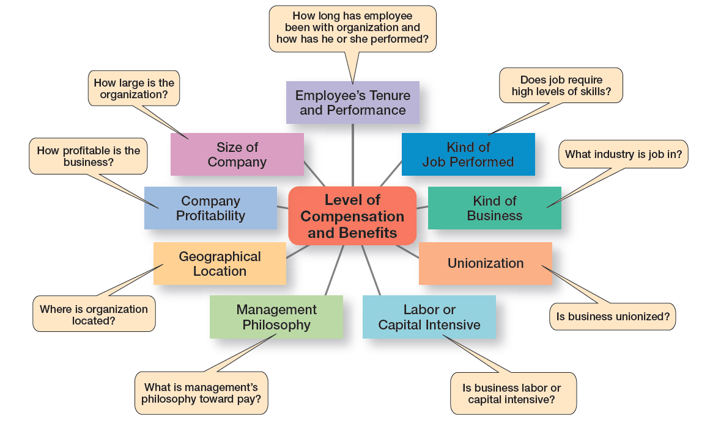
Exhibit 12-11 What Determines Pay and Benefits
Exhibit 12-11 summarizes the factors that influence the compensation and benefit packages that different employees receive.
Notes:
How do managers determine who gets paid what? Several factors influence the compensation and benefit packages that different employees receive. Exhibit 12-11 summarizes these factors, which are job-based and business- or industry-based. Many organizations, however, are using alternative approaches to determining compensation: skill-based pay and variable pay.

Slide 39
L06: CONTEMPORARY issues in managing human resources
contemporary HR issues facing today’s managers. These concerns include managing downsizing, sexual harassment, and controlling HR costs.

Slide 40
Managing Downsizing
Downsizing: the planned elimination of jobs in an organization
Notes:
Downsizing (or layoffs) is the planned elimination of jobs in an organization. When an organization has too many employees—which can happen when it’s faced with an economic recession, declining market share, too aggressive growth, or poorly managed operations—one option for improving profits is to eliminate some of those excess workers. During the most current economic recession, many well-known companies downsized—including, among others, Boeing, Nokia, Procter & Gamble, Hewlett-Packard, Volkswagen, Dell, General Motors, Unisys, Siemens, Merck, Honeywell, and eBay.
Years since the recession ended, layoffs continue, although not as frequently. Some HR experts suggest that a “cost” associated with mass layoffs is the damage they can cause to long-term growth prospects.

Slide 41
Exhibit 12-12: Tips for Managing Downsizing
Tip
Treat everyone with respect.
Communicate openly and honestly: *Inform those being let go as soon as possible. *Tell surviving employees the new goals and expectations. *Explain impact of layoffs.
Follow any laws regulating severance pay or benefits.
Provide support/counseling for surviving (remaining) employees.
Reassign roles according to individuals’ talents and backgrounds.
Focus on boosting morale: *Offer individualized reassurance. *Continue to communicate, especially one-on-one. *Remain involved and available.
Have a plan for the empty office spaces/cubicles so it isn’t so depressing for surviving employees.
Notes:
How can managers best manage a downsized workplace? Disruptions in the workplace and in employees’ personal lives should be expected. Stress, frustration, anxiety, and anger are typical reactions of both individuals being laid off and the job survivors. Exhibit 12-12 lists some ways that managers can lessen the trauma both for the employees being laid off and for the survivors.

Slide 42
Managing Sexual Harassment
Sexual harassment: any unwanted action or activity of a sexual nature that explicitly or implicitly affects an individual’s employment, performance, or work environment
Notes:
Sexual harassment is a serious issue in both public and private sector organizations. During 2015 (the latest data available), more than 6,800 complaints were led with the EEOC, a drop from 7,944 in 2010. Although most complaints are led by women, the percentage of charges led by males was 17.6 percent. The costs of sexual harassment are high. Almost all Fortune 500 companies in the United States have had complaints lodged by employees, and at least a third have been sued. Settlements can range from low thousands to millions.

Slide 43
Controlling HR Costs
Employee health-care costs
Employee pension plan costs
Notes:
Is it any wonder that organizations are looking for ways to control their health care costs? How? First, many organizations are providing opportunities for employees to lead healthy lifestyles. From financial incentives to company-sponsored health and wellness programs, the goal is to limit rising health care costs. About 41 percent of companies use some type of positive incentives aimed at encouraging healthy behavior, up from 34 percent in 1996.
Obviously, the pension issue is one that directly affects HR decisions. On the one hand, organizations want to attract talented, capable employees by offering them desirable benefits such as pensions. But on the other hand, organizations have to balance offering benefits with the costs of providing such benefits.

Slide 44
Review Learning Objective 12.1
Explain the importance of human resource management and the Human Resource Management Process.
1. Competitive advantage
2. Organizational strategies
3. Impact of employee treatment on organizational performance
Notes:
HRM is important for three reasons. First, it can be a significant source of competitive advantage. Second, it’s an important part of organizational strategies. Finally, the way organizations treat their people has been found to significantly impact organizational performance.

Slide 45
Review Learning Objective 12.2
Describe the the external influences that affect the human resources management process.
Economy
Labor unions
Legal environment
Demographic trends
Notes:
The economy affects how employees view their work and has implications for how an organization manages its human resources. A labor union is an organization that represents workers and seeks to protect their interests through collective bargaining. In unionized organizations, HRM practices are dictated by collective bargaining agreements. HRM practices are governed by a country’s laws and not following those laws can be costly. Demographic trends such as changes in the racial and ethnic composition of the workforce, retiring Baby Boomers, and an expanding cohort of Gen Y workers will also have implications for HRM practices.

Slide 46
Review Learning Objective 12.3
Discuss the tasks associated with identifying and selecting competent employees.
Planning:
Job analysis
Job description
Job specification
Recruitment/decruitment
Selection
Realistic job preview
Notes:
Human resource planning is the process by which managers ensure they have the right number and kinds of capable people in the right places at the right times.
Employers must cautiously screen potential job applicants.
A valid selection device is characterized by a proven relationship between the selection device and some relevant criterion. A reliable selection device indicates that it measures the same thing consistently. The different selection devices include application forms, written and performance-simulation tests, interviews, background investigations, and in some cases physical exams.
A realistic job preview is important because it gives an applicant more realistic expectations about the job, which in turn should increase employee job satisfaction and reduce turnover.

Slide 47
Review Learning Objective 12.4
Explain how companies provide employees with skills and knowledge.
Orientation
Training:
Profession/industry-specific training
Management/supervisory skills
Mandatory/compliance information
Customer service training
Traditional training versus technology-based methods
Notes:
Orientation is important because it results in an outsider-insider transition that makes the new employee feel comfortable and fairly well adjusted, lowers the likelihood of poor work performance, and reduces the probability of an early surprise resignation.
The most popular types of training include profession/industry-specific training, management/supervisory skills, mandatory/compliance information, and customer service training. This training can be provided using traditional training methods (on the job, job rotation, mentoring and coaching, experiential exercises, workbooks/manuals, and classroom lectures) or by technology-based methods (CD/DVD/videotapes/ audiotapes, videoconferencing or teleconferencing, or e-learning).

Slide 48
Review Learning Objective 12.5
Describe strategies for retaining competent, high-performing employees.
Performance management system
Performance appraisal methods
Factors influencing compensation and benefits
Skill-based pay systems versus variable pay system
Notes:
A performance management system establishes performance standards used to evaluate employee performance. The different performance appraisal methods are writ- ten essays, critical incidents, graphic rating scales, BARS, multiperson comparisons, MBO, and 360-degree appraisals.
The factors that influence employee compensation and benefits include the employee’s tenure and performance, kind of job performed, kind of business/industry, unionization, whether it is labor or capital intensive, management philosophy, geo- graphical location, company profitability, and size of company.
Skill-based pay systems reward employees for the job skills and competencies they can demonstrate. In a variable pay system, an employee’s compensation is contingent on performance.

Slide 49
Review Learning Objective 12.6
Discuss contemporary issues in managing human resources.
Downsizing
Sexual harassment
Controlling HR costs
Notes:
Managers can manage downsizing by communicating openly and honestly, following appropriate laws regarding severance pay or benefits, providing support/counseling for surviving employees, reassigning roles according to individuals’ talents and backgrounds, focusing on boosting morale, and having a plan for empty office spaces.
Sexual harassment is any unwanted action or activity of a sexual nature that explicitly or implicitly affects an individual’s employment, performance, or work environment. Managers need to be aware of what constitutes an offensive or hostile work environment, educate employees on sexual harassment, and ensure that no retaliatory actions are taken against any person who files harassment charges. Also, they may need to have a policy in place for workplace romances.
Organizations are dealing with work–family life balance issues by offering family-friendly benefits such as on-site child care, flextime, telecommuting, and so on. Managers need to understand that people may prefer programs that segment work and personal lives, while others prefer programs that integrate their work and personal lives.
Organizations are controlling HR costs by controlling employee health care costs through employee health initiatives (encouraging healthy behavior and penalizing unhealthy behaviors) and controlling employee pension plans by eliminating or severely limiting them.

Slide 50
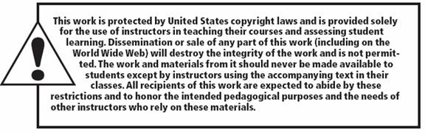
Copyright

